Slide 1
Chunks of the FI 393 course
Bonds
Valuing promises to pay you cash
Firms’ goal
Measuring cash flow
Stocks
Capital investments

Slide 2
Valuing promises: Step 2
Valuing promises to pay you cash
Step 1:
A single
promise
Step 2:
Multiple promises

Slide 3
Chapter 4 Time Value of Money 2: Analyzing Annuity Cash Flows
McGraw-Hill/Irwin
Copyright © 2014 by the McGraw-Hill Companies, Inc. All rights reserved.

Slide 4
Introduction
Most problems/decisions individuals and businesses face involve multiple cash flows over time.
Ex: Car loans require equal monthly payments over a number of years
Ex: General Motors paid a $0.50 per share quarterly dividend for 6 straight years before reducing it to $0.25 in 2006.
Ex: Apple pays $22,250 semiannual interest through May 2044 on one of its outstanding bond issues.
Each of these situations involve payments and interest compounding over different time intervals—monthly for car loans, quarterly for dividend payments and so on.

Slide 5
Introduction
How do we value these payments on common or comparable terms?
In this chapter, we will cover how to value multiple cash flows over time and how to incorporate different interest compounding frequencies.

Slide 6
Key Concepts and Skills
Compute the future value of multiple cash flows
Compute the present value of multiple cash flows
Compute loan payments
Find the interest rate on a loan
Understand how loans are amortized or paid off
Understand how interest rates are quoted

Slide 7
Chapter Outline
Multiple Cash Flows: Future and Present Values
Multiple Equal Cash Flows: Annuities and Perpetuities
Comparing Rates: the Effect of Compounding
Loan Types
Loan Amortization

Slide 8
Single Cash Flows
In the previous chapter, we used single cash flows and moved them forward and backward in time.
Today
1
2
3
4
5
PV
FV
Today
1
2
3
4
5
PV
FV

Slide 9

Multiple Cash Flows
What if we have more than one cash flow?
For example, if you open a business, there will be a large cash outflow at the beginning and then cash inflows for many years afterward. (You hope!)
The concept (and formula) are identical if we simply look at the problem as a series of single payments.

Slide 10
Future Value with Multiple Cash Flows: Example 1
Suppose you have $1,000 now in a savings account that is earning 6%. You want to add $500 one year from now and $700 two years from now.
How much will you have two years from now in your savings account (after you make your $700 deposit)?
Today
1 Year
2 Years
?
$1,000
$500
$700

Slide 11
Future Value with Multiple Cash Flows: Example 1
Simply look at each payment separately and move them through time as we did in the earlier chapter.
Today
1 Year
2 Years
$1,000
$ 500
$ 700
Now just add them up
because they are all
adjusted to be in “year 3” value
$
Notes:
It is important to point out that the last deposit of $700 was NOT adjusted in time as it already is in the time period we want: 2 years.
The idea of adding money up in the identical time frame is critical to the understanding of the time value of money. We cannot simply add up the $1,000 + $500 + $700 because they are in different time periods.
The future value of the $1,000 original deposit is actually $1,123.60 but it was rounded up to the nearest dollar for visual simplicity.

Slide 12
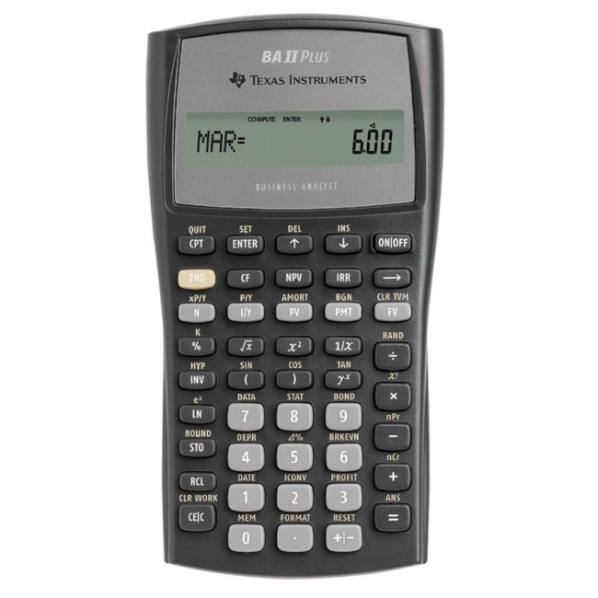
TI BA II Plus
N =
1123.60
I/Y =
PV =
1st
CPT
? = FV
2nd
Notes:
This demonstration is a refresher of how to use the calculator, taking the $1,000 today and computing its future value at time 2.
Students should be capable of computing the future value of the $500 payment on their own.

Slide 13
Future Value with Multiple Cash Flows: Example 1B
Could we do this problem another way?
Bring each of the cash flows forward one year at a time and add them up each year.
Today
1 Year
2 Years
$1,000
$ 500
$ 700
1,060
$1,560
1,060
1,060
Notes:
It is important to point out that the last deposit of $700 was NOT adjusted in time as it already is in the time period we want: 2 years.
The idea of adding money up in the identical time frame is critical to the understanding of the time value of money. We cannot simply add up the $1,000 + $500 + $700 because they are in different time periods.
The future value of the $1,560 year one total is actually $1,653.60 but it was rounded up to the nearest dollar for visual simplicity.

Slide 14
Future Value with Multiple Cash Flows: Example 1C
Let’s add one more twist to the problem:
What would be the value at year 5 if we made no further deposits into our savings account?
Today
1
2
3
4
5
?
$1,000
500
700

Slide 15
Future Value with Multiple Cash Flows: Example 1C
We could do this two different ways:
1. Bring the “year two” figure we previously produced to year five
Today
1
2
3
4
5
$1,000
500
700
2,353.60
2,803.18
2,353.60 x (1.06)^3= 2,803.18

Slide 16
Future Value with Multiple Cash Flows: Example 1C
We could do this two different ways:
2. Bring each of the three original dollars to year 5 and add them all up.
Today
1
2
3
4
5
$1,000
500
700
1338.23
631.24
833.71
2,803.18
Notes:
With rounding up to dollars, we achieve the identical answer.

Slide 17
Present Value with Multiple Cash Flows
To compute the present value of multiple cash flows, we again just bring the payments into the present value – one year at a time.

Slide 18
Present Value with Multiple Cash Flows: Example 1
Consider receiving the following cash flows:
Year 1 CF = $200
Year 2 CF = $400
Year 3 CF = $600
Year 4 CF = $800
If the discount rate is 12%, what would this cash flow be worth today?

Slide 19
Present Value with Multiple Cash Flows: Example 1
Visually, the time line
would look like this:
Today
1
2
3
4
?
200
400
600
800
178.57

Slide 20
Present Value with Multiple Cash Flows: Example 1
To compute the present value of this future stream of cash, we just take each year to the present, one at a time:
Today
1
2
3
4
200
400
600
800
178.57
318.88
427.07
508.41
1432.93

Slide 21
Present Value with Multiple Cash Flows: Example 1
Using a calculator, find the PV of each cash flow and just add them up!
Year 1 CF: N = 1; I/Y = 12; FV = 200; CPT PV = -178.57
Year 2 CF: N = 2; I/Y = 12; FV = 400; CPT PV = -318.88
Year 3 CF: N = 3; I/Y = 12; FV = 600; CPT PV = -427.07
Year 4 CF: N = 4; I/Y = 12; FV = 800; CPT PV = - 508.41
Total PV = 178.57 + 318.88 + 427.07 + 508.41 = $1,432.93
Notes:
The students can read the example in the book.
You are offered an investment that will pay you $200 in one year, $400 the next year, $600 the next year and $800 at the end of the next year. You can earn 12 percent on very similar investments. What is the most you should pay for this one?
Point out that the question could also be phrased as “How much is this investment worth?”
Remember the sign convention. The negative numbers imply that we would have to pay 1,432.93 today to receive the cash flows in the future.
Formula:
Year 1 CF: 200 / (1.12)¹ = 178.57
Year 2 CF: 400 / (1.12)² = 318.88
Year 3 CF: 600 / (1.12)³ = 427.07
Year 4 CF: 800 / (1.12)⁴ = 508.41
Calculator:
Year 1 CF: N = 1; I/Y = 12; FV = 200; CPT PV = -178.57
Year 2 CF: N = 2; I/Y = 12; FV = 400; CPT PV = -318.88
Year 3 CF: N = 3; I/Y = 12; FV = 600; CPT PV = -427.07
Year 4 CF: N = 4; I/Y = 12; FV = 800; CPT PV = - 508.41
Total PV = 178.57 + 318.88 + 427.07 + 508.41 = 1,432.93

Slide 22
Present Value with Multiple Cash Flows: Example 2
You are considering an investment that will pay you $1,000 in one year, $2,000 in two years and $3,000 in three years. If you want to earn 10% on your money, how much would you be willing to pay?
N = 1; I/Y = 10; FV = 1,000; CPT PV = -909.09
N = 2; I/Y = 10; FV = 2,000; CPT PV = -1,652.89
N = 3; I/Y = 10; FV = 3,000; CPT PV = -2,253.94
PV = 909.09 + 1,652.89 + 2,253.94 = 4,815.93
Notes:
Formula:
PV = 1000 / (1.1)¹ = 909.09
PV = 2000 / (1.1)² = 1,652.89
PV = 3000 / (1.1)³ = 2,253.94
Calculator:
N = 1; I/Y = 10; FV = 1000; CPT PV = -909.09
N = 2; I/Y = 10; FV = 2000; CPT PV = -1,652.89
N = 3; I/Y = 10; FV = 3000; CPT PV = -2,253.94

Slide 23
Multiple Uneven Cash Flows Using the TI BA II + Calculator
Another way to use the financial calculator for uneven cash flows is to use the cash flow keys
Press CF and enter the cash flows beginning with year 0.
You have to press the “Enter” key for each cash flow
Use the down arrow key to move to the next cash flow
The “F” is the number of times a given cash flow occurs in consecutive periods
Use the NPV key to compute the present value by entering the interest rate for I, press “Enter”, then the down arrow, and then “CPT” computing the answer
Clear the cash flow worksheet by pressing CF and then 2nd CLR Work
Notes:
The next example will be worked using the cash flow keys.
Note that with the BA-II Plus, the students can double check the numbers they have entered by pressing the up and down arrows. It is similar to entering the cash flows into spreadsheet cells.
Other calculators also have cash flow keys. You enter the information by putting in the cash flow and then pressing CF. You have to always start with the year 0 cash flow, even if it is zero.
Remind the students that the cash flows have to occur at even intervals, so if you skip a year, you still have to enter a 0 cash flow for that year.

Slide 24
Decisions, Decisions
Your broker calls you and tells you that he has this great investment opportunity. If you invest $100 today, you will receive $40 in one year and $75 in two years. If you require a 15% return on investments of this risk, should you take the investment?
Use cash flow keys:
CF
2nd CE/C
CF0 0 ENTER
C01 40 ENTER
F01 1 ENTER
C02 75 ENTER
F02 1 ENTER
NPV
I 15 ENTER DOWN CPT
91.49
No! – the broker is charging more than you would be willing to pay ($100 versus the NPV of $ )
91.49
Notes:
You can also use this as an introduction to NPV by having the students put –100 in for CF₀. When they compute the NPV, they will get –8.51. You can then discuss the NPV rule and point out that a negative NPV means that you do not earn your required return. You should also remind them that the sign convention on the regular TVM keys is NOT the same as getting a negative NPV.

Slide 25
TI BA II Plus
CF
91.49
0 = CF₀ ; ↓
40 = CO1; ↓
1 = FO1; ↓
75 = CO2; ↓
1 = FO2; ↓
NPV
15 = I
1st
↓
2nd
CPT
6-25
Notes:
You must use the down arrow key (↓) to move to the next cash flow.
If student’s use -$100 for CF₀, then they will obtain the NPV as the answer and not the PV of the cash flows. NPV will be discussed in detail in a later chapter with calculator examples presented.

Slide 26
Quick Quiz I
Suppose you are looking at the following possible cash flows: Year 1 CF = $100; Years 2 and 3 CFs = $200; Years 4 and 5 CFs = $300. The required discount rate is 7%.
What is the value of the cash flows today?
NPV = 874.17
What is the value of the cash flows at year 5?
PV = -874.17, N = 5, I/Y = 7%, FV = ? → 1226.07.
Notes:
The easiest way to work this problem is to use the uneven cash flow keys and find the present value first and then compute the others based on that.
CF₀ = 0; C01 = 100; F01 = 1; C02 = 200; F02 = 2; C03 = 300; F03 = 2; I = 7; CPT NPV = 874.17
Value in year 5: PV = 874.17; N = 5; I/Y = 7; CPT FV = 1,226.07
Value in year 3: PV = 874.17; N = 3; I/Y = 7; CPT FV = 1,070.90
Using formulas and one CF at a time:
Year 1 CF: FV₅ = 100(1.07)⁴ = 131.08; PV₀ = 100 / 1.07 = 93.46; FV₃ = 100(1.07)² = 114.49
Year 2 CF: FV₅ = 200(1.07)³ = 245.01; PV₀ = 200 / (1.07)² = 174.69; FV₃ = 200(1.07) = 214
Year 3 CF: FV₅ = 200(1.07)² = 228.98; PV₀ = 200 / (1.07)³ = 163.26; FV₃ = 200
Year 4 CF: FV₅ = 300(1.07) = 321; PV₀ = 300 / (1.07)⁴ = 228.87; PV₃ = 300 / 1.07 = 280.37
Year 5 CF: FV₅ = 300; PV₀ = 300 / (1.07)⁵ = 213.90; PV₃ = 300 / (1.07)² = 262.03
Value at year 5 = 131.08 + 245.01 + 228.98 + 321 + 300 = 1,226.07
Present value today = 93.46 + 174.69 + 163.26 + 228.87 + 213.90 = 874.18 (difference due to rounding)
Value at year 3 = 114.49 + 214 + 200 + 280.37 + 262.03 = 1,070.89

Slide 27
Chapter Outline
Multiple Cash Flows: Future and Present Values
Multiple Equal Cash Flows: Annuities and Perpetuities
Comparing Rates: the Effect of Compounding
Loan Types
Loan Amortization

Slide 28
Valuing Level Cash Flows: Annuities and Perpetuities
It is common to encounter situations in which we have multiple cash flows that are all of the same amount.
Example: Car or mortgage payments
Thus, we will look at two types of level cash flow financial arrangements: Annuities and Perpetuities.

Slide 29
Annuities and Perpetuities Definitions
Annuity – finite series of equal payments that occur at regular intervals
If the first payment occurs at the end of the period, it is called an ordinary annuity
If the first payment occurs at the beginning of the period, it is called an annuity due
Perpetuity – infinite series of equal payments.

Slide 30
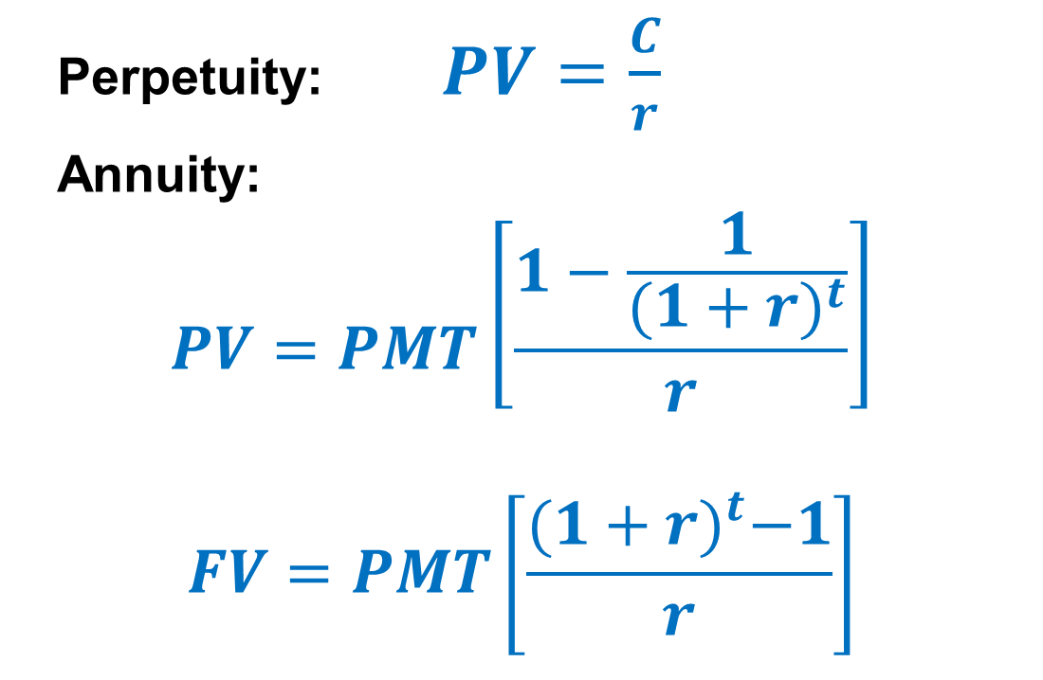
Annuities and Perpetuities Basic Formulas
Perpetuity: $PV=\frac{C}{r}$
Annuity:
$$PV=PMT\left[\frac{1−\frac{1}{{(1+r)}^{t}}}{r}\right]$$
$$FV=PMT\left[\frac{{(1+r)}^{t}−1}{r}\right]$$
Notes:
Lecture Tip: The annuity factor approach is a short-cut approach in the process of calculating the present value of multiple cash flows and that it is only applicable to a finite series of level cash flows. Financial calculators have reduced the need for annuity factors, but it may still be useful from a conceptual standpoint to show that the PVIFA is just the sum of the PVIFs across the same time period.

Slide 31
Annuities and the Calculator
The PMT key on the calculator is used for the equal payment
The sign convention still holds
Ordinary annuity versus Annuity due
Switch your calculator between the two types (next slide)
If you see “BGN” or “Begin” in the display of your calculator, you have it set for an annuity due
Most problems are ordinary annuities!

Slide 32
TI BAII+: Set Annuity Time Value Parameters
Set END for an ordinary annuity or BGN for an annuity due
Press 2nd BGN (above PMT)
This is a toggle switch. The default is END.
To change to BEGIN, press 2nd SET (above ENTER) to go back and forth.

Slide 33
Important Points to Remember
Interest rate and time period must match!
Annual periods ⇒ annual rate
Monthly periods ⇒ monthly rate
The Sign Convention
Cash inflows are positive
Cash outflows are negative

Slide 34
Sign Convention Example
5 N
10 I/Y
-100 PV
20 PMT
CPT FV = $_____
Implies you deposited $100 today and plan to _________ $20 a year for 5 years
5 N
10 I/Y
-100 PV
-20 PMT
CPT FV = $_____
Implies you deposited $100 today and plan to ______ $20 a year for 5 years
+CF = Cash INFLOW to YOU
-CF = Cash OUTFLOW from you

Slide 35
Annuity: Buying a Car
After carefully going over your budget, you have determined you can afford to pay $632 per month towards a new sports car. You call up your local bank and find out that the going rate is 12 percent per year for a 4 year loan. How much can you borrow?
Notes:
The students can read the example in the book.
Note that the difference between the answer here and the one in the book is due to the rounding of the Annuity PV factor in the book.

Slide 36
Annuity: Buying a Car
You borrow money TODAY so you need to compute the .
N = ; I/Y= ; PMT = ;
CPT =
Formula:
Notes:
The students can read the example in the book.
After carefully going over your budget, you have determined you can afford to pay $632 per month towards a new sports car. You call up your local bank and find out that the going rate is 1 percent per month for 48 months. How much can you borrow?
Note that the difference between the answer here and the one in the book is due to the rounding of the Annuity PV factor in the book.

Slide 37

Saving For Retirement
You are offered the opportunity to put some money away for retirement. You will receive five annual payments of $25,000 each, beginning in 40 years.
How much would you be willing to invest today if you desire an interest rate of 12%?

Slide 38
Saving For Retirement Timeline
0 1 2 … 39 40 41 42 43 44
0 0 0 … 0 25K 25K 25K 25K 25K
Use the CF keys:
CF0 = 0
C01 = 0
F01 = 39
Hit NPV:
I = 12
CPT NPV = ?
→
C02 = 25,000
F02 = 5
Notes:
Use cash flow keys for the TI BA II +:
CF; CF₀ = 0; C01 = 0; F01 = 39; C02 = 25,000; F02 = 5; NPV; I = 12; CPT NPV = 1,084.71
Use the cash flow keys for the HP 12C:
“g” CF0 = 0; “g” Nj = 40; “g” CFj = 25,000; “g” CFj = 25,000; “g” CFj = 25,000; “g” CFj = 25,000; “g” CFj = 25,000; I = 12; “f” NPV = 1,084.71.
The HP and the TI approach annuities slightly differently, which can be a cause for problems if both calculator types are used.

Slide 39
Finding the Payment
Suppose you want to borrow $20,000 for a new car. You can borrow at 8% per year, compounded monthly
(8/12 = 0.66667% per month).
If you take a 4-year loan, what is your monthly payment?
N = 4x12=48 ; PV = 20,000; I/Y = 8/12 ;
CPT PMT = 488.26
Notes:
Note if you do not round the monthly rate and actually use 8/12, then the payment will be 448.30
Formula
20,000 = PMT[1 – 1 / 1.0066667⁴⁸] / .0066667
PMT = 488.26
Calculator:
4(12) = 48 N; 20,000 PV; .66667 I/Y; CPT PMT = 488.26

Slide 40
Finding the Number of Payments I
You ran a little short on your spring break vacation, so you put $1,000 on your credit card. You can only afford to make the minimum payment of $20 per month. The interest rate on the credit card is 1.5 percent per month.
How long will you need to pay off the $1,000?
Notes:
This is an excellent opportunity to talk about credit card debt and the problems that can develop if it is not handled properly. Many students don’t understand how it works, and it is rarely discussed. This is something that students can take away from the class, even if they aren’t finance majors.

Slide 41
Finding the Number of Payments I
The sign convention matters!
I/Y = 1.5
PV = 1000
PMT = 20
CPT N = 93.11 MONTHS = 7.76 years
And this is only if you don’t charge anything more on the card!
Notes:
Formula:
1000 = 20(1 – 1/1.015^{t}) / .015
.75 = 1 – 1 / 1.015^{t}
1 / 1.015^{t} = .25
1 / .25 = 1.015^{t}
t = ln(1/.25) / ln(1.015) = 93.111 months = 7.75 years
Calculator:
1.5 I/Y
1,000 PV
-20 PMT
CPT N = 93.111 MONTHS = 7.75 years

Slide 42
Finding the Number of Payments II
Suppose you borrow $2,000 at 5%, and you are going to make annual payments of $734.42.
How long before you pay off the loan?
(the sign convention matters!)
I/Y = 5%
PV = 2000
PMT = 734.42
CPT N = 2.73
Notes:
Formula:
2000 = 734.42(1 – 1/1.05^{t}) / .05
.136161869 = 1 – 1/1.05^{t}
1/1.05^{t} = .863838131
1.157624287 = 1.05^{t}
t = ln(1.157624287) / ln(1.05) = 3 years
Calculator:
Sign convention matters!!!
5 I/Y
2,000 PV
-734.42 PMT
CPT N = 3 years

Slide 43
Chapter Outline
Multiple Cash Flows: Future and Present Values
Multiple Equal Cash Flows: Annuities and Perpetuities
Comparing Rates: the Effect of Compounding
Loan Types
Loan Amortization

Slide 44
Finding the Rate
Suppose you borrow $25,000 from your parents to buy a car. You agree to pay $207.58 per month for 60 months.
What is the monthly interest rate?
(The sign convention matters!)
N = 60 mnths
PV = 25,000
PMT = 207.58
CPT I/Y = -2.05
Notes:
The next slide talks about how to do this without a financial calculator.

Slide 45
Future Values for Annuities
Suppose you begin saving for your retirement by depositing $2,000 per year in an IRA. If the interest rate is 7.5%, how much will you have in 40 years?
(Remember the sign convention!)
N = 40
I/Y = 7.5
PMT = 2,000
CPT FV = 454513.04
Notes:
Formula:
FV = 2000(1.075⁴⁰ – 1)/.075 = 454,513.04
Calculator:
Remember the sign convention!!!
40 N
7.5 I/Y
-2,000 PMT
CPT FV = 454,513.04
Lecture Tip: It should be emphasized that annuity factor tables (and the annuity factors in the formulas) assumes that the first payment occurs one period from the present, with the final payment at the end of the annuity’s life. If the first payment occurs at the beginning of the period, then FV’s have one additional period for compounding and PV’s have one less period to be discounted. Consequently, you can multiply both the future value and the present value by (1 + r) to account for the change in timing.

Slide 46
Annuity Due
You are saving for a new house and you need 20% down to get a loan. You put $10,000 per year in an account paying 8%. The first payment is made today.
How much will you have at the end of 3 years
(you make a total of three $10,000 payments)?
2nd BGN 2nd Set (you should see BGN in the display)
N = 3
PMT = 10,000
I/Y = 8
CPT FV = 35061.12
(“2nd BGN 2nd Set” needs to be changed back to an ordinary annuity when you are finished)
Notes:
Note that the procedure for changing the calculator to an annuity due is similar on other calculators.
Formula:
FV = 10,000[(1.08³ – 1) / .08](1.08) = 35,061.12
Calculator:
2nd BGN 2nd Set (you should see BGN in the display)
3 N
-10,000 PMT
8 I/Y
CPT FV = 35,061.12
2nd BGN 2nd Set (be sure to change it back to an ordinary annuity)
What if it were an ordinary annuity? FV = 32,464 (so you receive an additional 2,597.12 by starting to save today.)

Slide 47
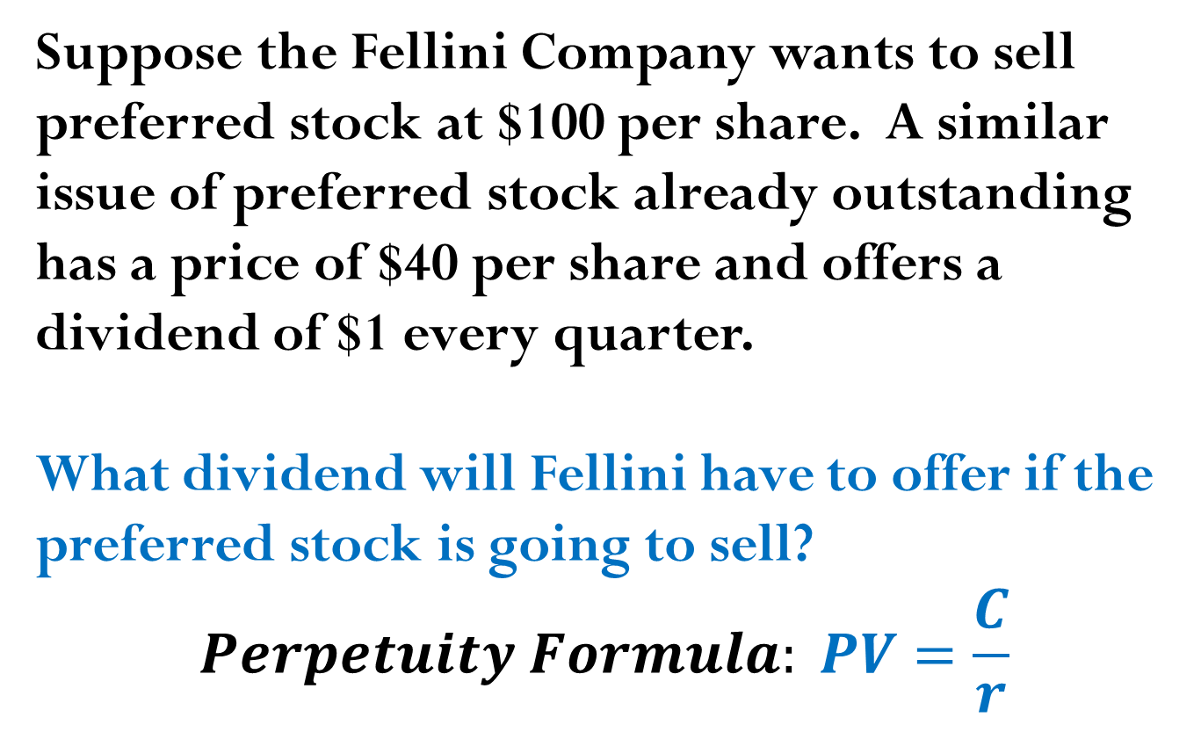
Perpetuity Example
Suppose the Fellini Company wants to sell preferred stock at $100 per share. A similar issue of preferred stock already outstanding has a price of $40 per share and offers a dividend of $1 every quarter.
What dividend will Fellini have to offer if the preferred stock is going to sell?
$$Perpetuity Formula: PV=\frac{C}{r}$$

Slide 48
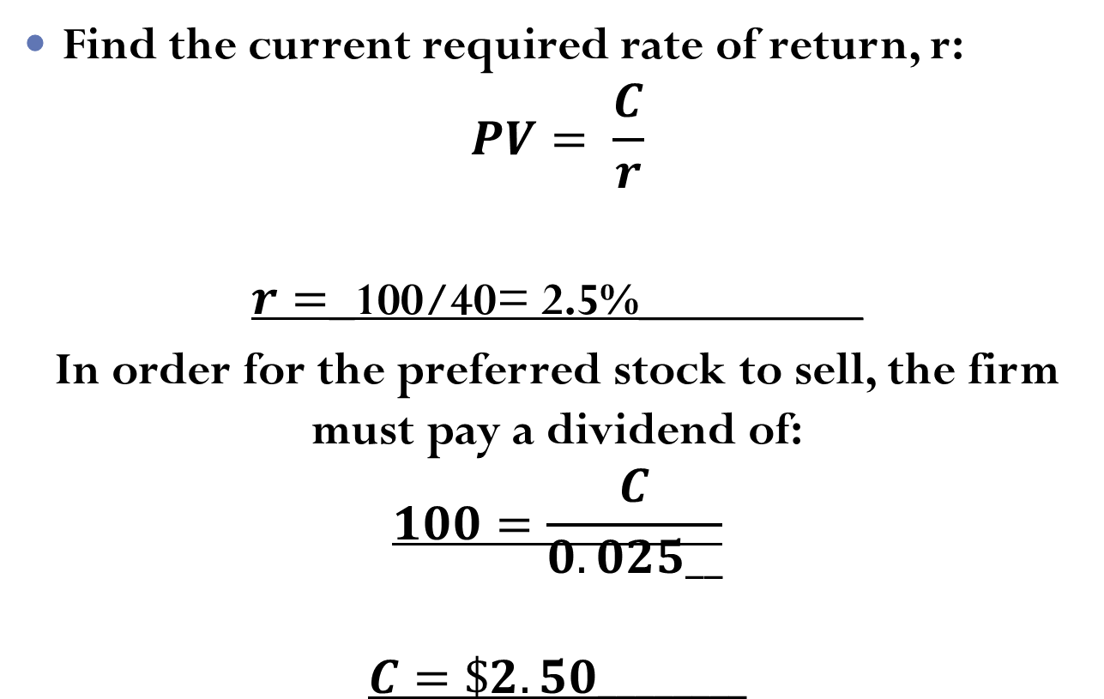
Perpetuity Example
Find the current required rate of return, r:
$$PV= \frac{C}{r}$$
$r=$_100/40= 2.5%_________
In order for the preferred stock to sell, the firm must pay a dividend of:
$$100=\frac{C}{0.025__}$$
$$C=\$2.50________$$

Slide 49
Chapter Outline
Multiple Cash Flows: Future and Present Values
Multiple Equal Cash Flows: Annuities and Perpetuities
Comparing Rates: the Effect of Compounding
Loan Types
Loan Amortization

Slide 50
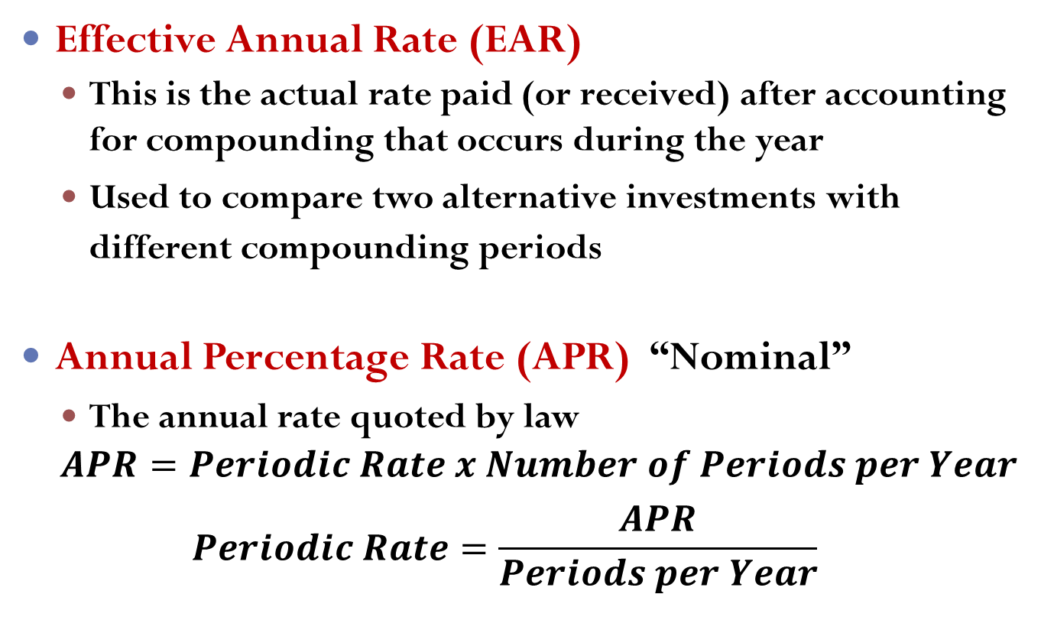
Interest Rates
Effective Annual Rate (EAR)
This is the actual rate paid (or received) after accounting for compounding that occurs during the year
Used to compare two alternative investments with different compounding periods
Annual Percentage Rate (APR) “Nominal”
The annual rate quoted by law
$$APR=Periodic Rate x Number of Periods per Year$$
$$Periodic Rate=\frac{APR}{Periods per Year}$$

Slide 51
Computing APRs
What is the APR if the monthly rate is 0.5%?
________________________
What is the APR if the semiannual rate is 0.5%?
_______________________
What is the monthly rate if the APR is 12% with monthly compounding?
_______________________

Slide 52

Things to Remember
You ALWAYS need to make sure that the interest rate and the time period match.
If you are looking at annual periods, you need an annual rate.
If you are looking at monthly periods, you need a monthly rate.

Slide 53
Things to Remember
If you have an APR based on monthly compounding, you have to use monthly periods for lump sums, or adjust the interest rate appropriately if you have payments other than monthly

Slide 54
Computing EARs Example
Suppose you can earn 1% per month on $1 invested today.
What is the APR? FV=PV(1tr)^t
1x12=12%
How much are you effectively earning?
FV = _1(1.01)^12____ = 1.1268
Rate (% ∆) = (_1.1268___ – 1) / 1
= 12.68%

Slide 55
Computing EARs Example (continued)
Suppose you put it in another account and earn 3% per quarter.
What is the APR?
3x4=12%
How much are you effectively earning?
FV = _1(1.03)^4__ = 1.1255
Rate = (_1.1255__ – 1) / 1
= 12.55
Notes:
Point out that the APR is the same in either case, but your effective rate is different. Ask them which account they should use.

Slide 56
EAR - Formula
Remember that the APR is the quoted rate, and “m” is the number of compounding periods per year
Notes:
Using the calculator:
The TI BA-II Plus has an I conversion key that allows for easy conversion between quoted rates and effective rates.
2nd I Conv NOM is the quoted rate; down arrow EFF is the effective rate; down arrow C/Y is compounding periods per year. You can compute either the NOM or the EFF by entering the other two pieces of information, then going to the one you wish to compute and pressing CPT.

Slide 57
Decisions, Decisions II
You are looking at two savings accounts. One pays 5.25% APR, with daily compounding. The other pays 5.3% APR with semiannual compounding.
Which account should you use?
First account:
EAR = (1 + 0.0525/365)^356 - 1 = 5.39%
Second account:
EAR = = 5.37%
Which account should you choose and why?
Notes:
Remind students that rates are quoted on an annual basis. The given numbers are APRs, not daily or semiannual rates.
Calculator:
2nd I conv 5.25 NOM Enter up arrow 365 C/Y Enter up arrow CPT EFF = 5.39%
5.3 NOM Enter up arrow 2 C/Y Enter up arrow CPT EFF = 5.37%

Slide 58
Decisions, Decisions II Continued
Let’s verify the choice. Suppose you invest $100 in each account. How much will you have in each account in one year?
First Account:
N = 365; I/Y = 5.25 / 365 = 0.014383562; PV = ;
CPT FV = 105.39
Second Account:
N = 2; I/Y = 5.3/2 = ; PV = 100;
CPT FV = 105.37
You have more money in the 1 account.
Notes:
It is important to point out that the daily rate is NOT .014, it is .014383562
First Account:
365 N; 5.25 / 365 = .014383562 I/Y; 100 PV; CPT FV = 105.39
Second Account:
2 N; 5.3 / 2 = 2.65 I/Y; 100 PV; CPT FV = 105.37
Lecture Tip: Here is a way to drive the point of this section home. Ask how many students have taken out a car loan. Now ask one of them what annual interest rate s/he is paying on the loan. Students will typically quote the loan in terms of the APR. Point out that, since payments are made monthly, the effective rate is actually more than the rate s/he just quoted, and demonstrate the calculation of the EAR.

Slide 59
Computing APRs from EARs
If you have an effective rate, how can you compute the APR? Rearrange the EAR equation and you get:

Slide 60
APR - Example
Suppose you want to earn an effective rate of 12% and you are looking at an account that compounds on a monthly basis. What APR must they pay?
Notes:
On the calculator: 2nd I conv down arrow 12 EFF Enter down arrow 12 C/Y Enter down arrow CPT NOM

Slide 61
Computing Payments with APRs
Suppose you want to buy a new computer system and the store is willing to allow you to make monthly payments. The entire computer system costs $3,500. The loan period is for 2 years, and the interest rate is 16.9% with monthly compounding.
What is your monthly payment?
N = 2x12=24
I/Y = 16.9/12=
PV = 3,500
FV = 0
CPT PMT = 172.88
Notes:
2(12) = 24 N; 16.9 / 12 = 1.408333333 I/Y; 3,500 PV; CPT PMT = -172.88
See the Lecture Tip in the IM for a discussion of situations that present a mismatch between the payment period and the compounding period.

Slide 62
Future Values with Monthly Compounding
Suppose you deposit $50 a month into an account that has an APR of 9%, based on monthly compounding.
How much will you have in the account in 35 years?
N =
I/Y =
PMT =
CPT FV =
Notes:
Formula:
FV = 50[1.0075⁴²⁰ – 1] / .0075 = 147,089.22
Calculator:
35(12) = 420 N
9 / 12 = .75 I/Y
50 PMT
CPT FV = 147,089.22

Slide 63
Present Value with Daily Compounding
You need $15,000 in 3 years for a new car. If you can deposit money into an account that pays an APR of 5.5% based on daily compounding, how much would you need to deposit?
N = 3x365=1095
I/Y = 5.5 / 365 = 0.015068493
FV = 15,000
CPT PV = -12718.56
Notes:
Formula:
FV = 15,000 / (1.00015068493)¹⁰⁹⁵ = 12,718.56
Calculator:
3(365) = 1095 N
5.5 / 365 = .015068493 I/Y
15,000 FV
CPT PV = -12,718.56

Slide 64
Chapter Outline
Multiple Cash Flows: Future and Present Values
Multiple Equal Cash Flows: Annuities and Perpetuities
Comparing Rates: the Effect of Compounding
Loan Types
Loan Amortization

Slide 65
Types of Loans
Pure Discount Loan
Interest-only Loan
Amortized with Fixed Principal payment
Amortized with Fixed Payment

Slide 66
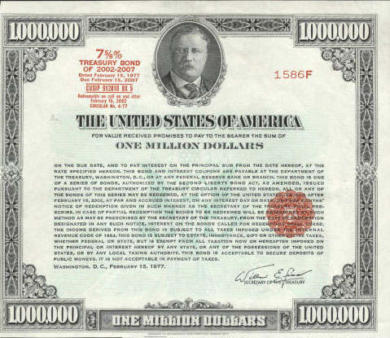
Pure Discount Loans
are excellent examples of pure discount loans. The borrower receives money today and the principal amount is repaid at some future date in a single lump sum, without any periodic interest payments.
Notes:
Remind students that the value of an investment is the present value of expected future cash flows.
Formula:
PV = 10,000 / 1.07 = 9345.79
Calculator:
1 N; 10,000 FV; 7 I/Y; CPT PV = -9,345.79

Slide 67
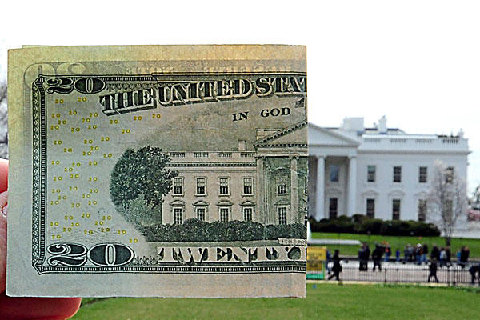
Pure Discount Loans
If a T-bill promises to repay $10,000 in 12 months and the market interest rate is 7 percent, how much will the bill sell for in the market?
N = 1 ; FV = 10,000 ; I/Y = 7 ;
CPT PV = -9,345.79
Notes:
Remind students that the value of an investment is the present value of expected future cash flows.
Formula:
PV = 10,000 / 1.07 = 9345.79
Calculator:
1 N; 10,000 FV; 7 I/Y; CPT PV = -9,345.79

Slide 68
Interest-Only Loan Definition
Interest-Only Loans: The borrower pays interest each period (e.g., month or year)and repays the entire principal (the original loan amount) at some point in the future (specifically, at maturity).
This cash flow stream is similar to the cash flows on ____Corporate Bonds___, and we will talk about them in greater detail later.

Slide 69
Interest-Only Loan Example
Consider a 5-year, interest-only loan with a 7% interest rate. The principal amount is $10,000. Interest is paid annually and the principal is repaid in a single lump sum at maturity.
What would the stream of cash flows be?
Years 1 – 4: Interest payments of _0.07(10,000)=700_
Year 5: Interest + principal = __10,700__

Slide 70
Chapter Outline
Multiple Cash Flows: Future and Present Values
Multiple Equal Cash Flows: Annuities and Perpetuities
Comparing Rates: the Effect of Compounding
Loan Types
Loan Amortization

Slide 71
Amortized Loans
__Amortized Loans_require the borrower to repay the _________ of the loan back over time (rather than all at once at the end of the loan).
The process of paying off a loan by making regular principal payments is called _Amortizing_ the loan.
Two types of amortization:
_Fixed principal payment loans__
____________________(principal amount varies with each payment)

Slide 72
Amortized Loan with Fixed Principal Payment - Example
Consider a $50,000, 10 year loan at 8% interest. The loan agreement requires the firm to pay $5,000 in principal each year plus interest for that year.
Click on the Excel icon to see the amortization table

Slide 73
Amortized Loan with Fixed Payment - Example
Fixed Payment Loan: Each payment is equal in amount covers the interest expense plus reduces principal.
Consider a 4 year loan with annual payments. The interest rate is 8%, and the principal amount is $5,000.
What is the annual payment?
N = 4
I/Y = 8
PV = 5,000
CPT PMT = -1,509.60
Click on the Excel icon to see the amortization table.
Notes:
Lecture Tip: Consider a $200,000, 30-year loan with monthly payments of $1330.60 (7% APR with monthly compounding). You would pay a total of $279,016 in interest over the life of the loan. Suppose instead, you cut the payment in half and pay $665.30 every two weeks (note that this entails paying an extra $1330.60 per year because there are 26 two week periods). You will cut your loan term to just under 24 years and save almost $70,000 in interest over the life of the loan. Calculations on TI-BAII plus First: PV = 200,000; N=360; I=7; P/Y=C/Y=12; CPT PMT = 1330.60 (interest = 1330.60*360 – 200,000) Second: PV = 200,000; PMT = -665.30; I = 7; P/Y = 26; C/Y = 12; CPT N = 614 payments / 26 = 23.65 years (interest = 665.30*614 – 200,000)

